Slide 1
QUIZ APPLICATION SYSTEM
BY
SHALINI K

Slide 2
ABSTRACT
The project: Quiz App System is contain number of questions. User can play/access the Quiz App System. There will be limited number of question and for each correct answer user will get credit score
In this system we have limited time for that questions so the user have answer the questions within a time. In last they show how many questions are right, wrong and final score of the quiz so that will help user to improve them.
By this application the user will come to know about his/her level and can learn additional knowledge. Also by this application a user can expand his/her knowledge among the world .

Slide 3
SCOPE
The scope of the project is very broad in terms of gaining knowledge and sharing knowledge among world.
Few points are:-
The application will be used in educational institution as well as in corporate world.
Can be used anywhere any time as it is a web based application
The application will be used in educational institution as well as in corporate world.

Slide 4
MODULES
Login
Sign Up
Home Page
Question page
About us
Feed Back
Contact us

Slide 5
LOGIN
Login module will help in the authentication of user accounts.
Users who have valid login id and password can only login into their respective accounts.

Slide 6
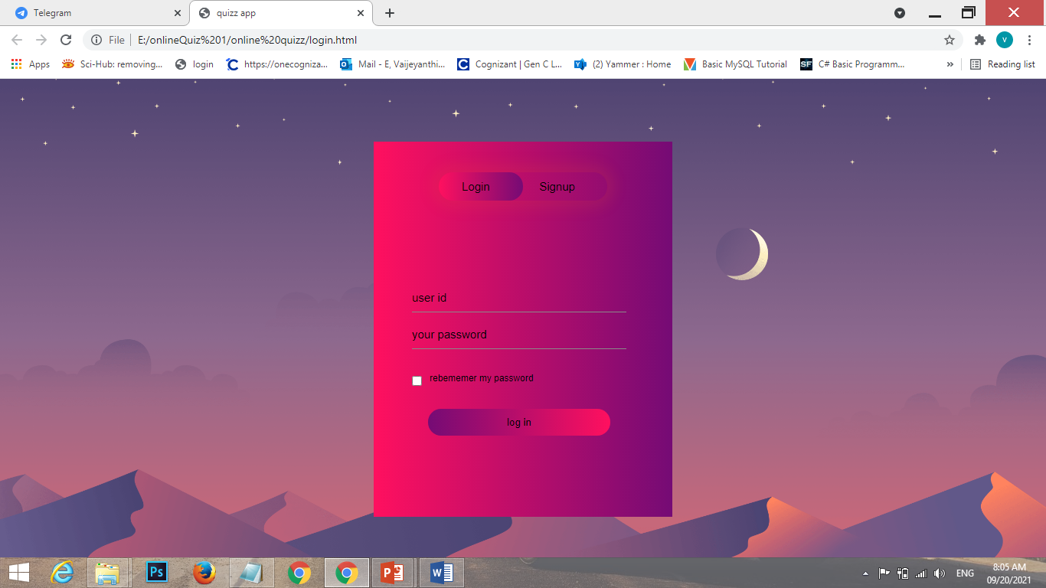
LOGIN SCREEN

Slide 7
SIGN UP
This module will help the user to register the credinals like name, email address and set password.This module will help the user get registered from anywhere if internet is present.
This module will really simplify the task of an paper registration.Also after successful registtration. u
By signing up the user can see the instruction of the quiz and they can attend the quiz.

Slide 8
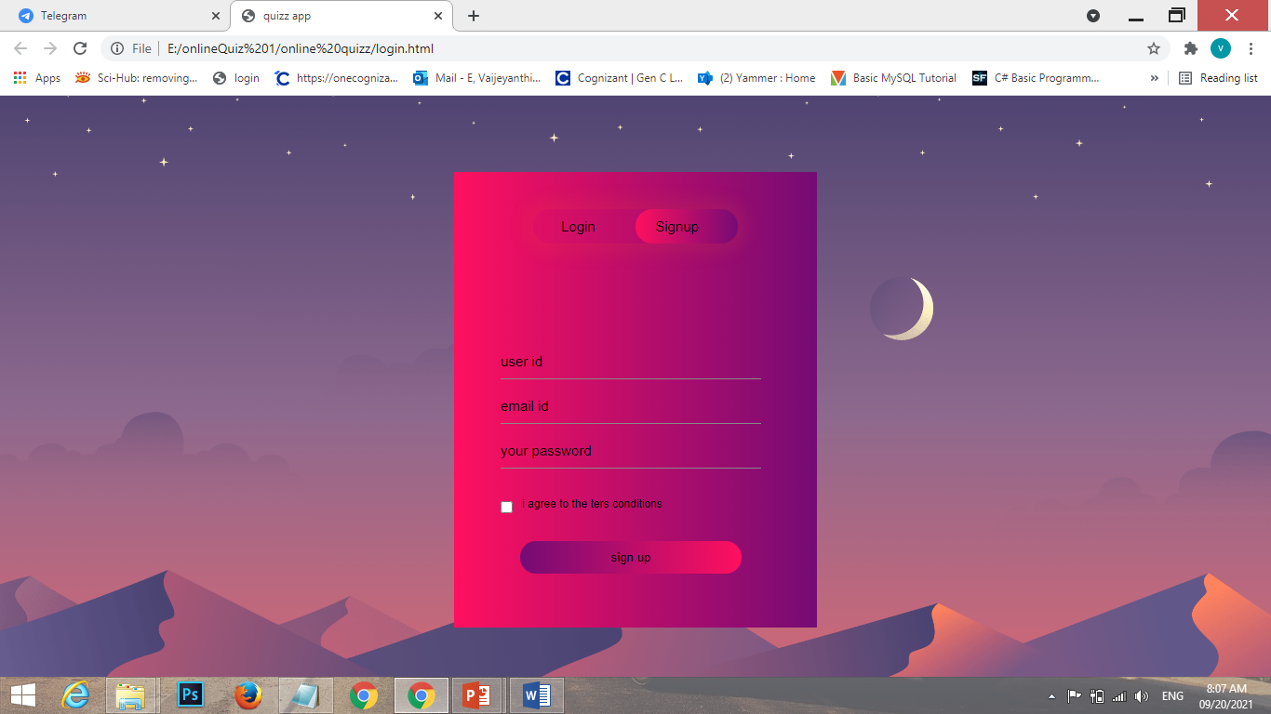
SIGN UP SCREEN

Slide 9
HOME PAGE
In this module we can find all the details regarding about us , feedback for the the user the give opinion of the quiz, contact us for if the user has any query they can contact, and also they have instuction for that quiz. Here we have start quiz button to quiz to start.

Slide 10
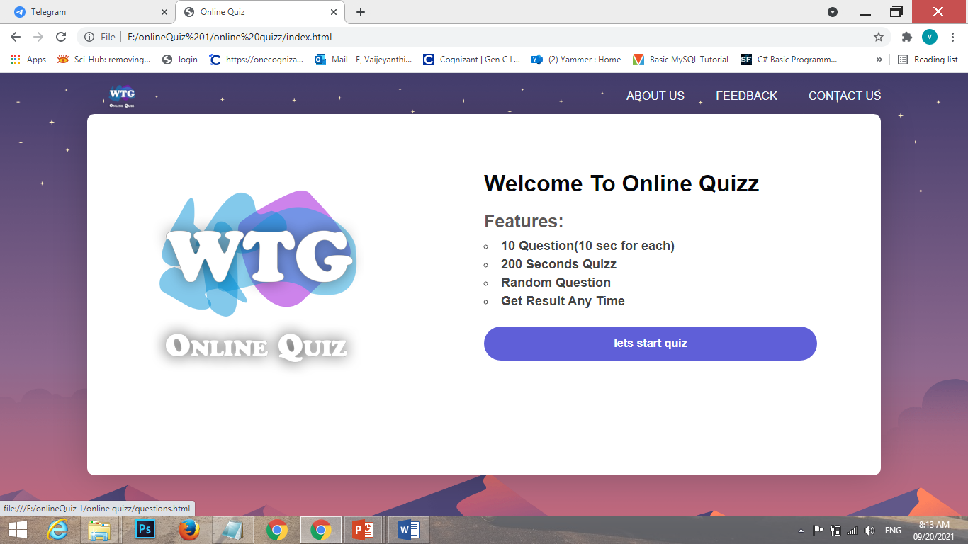
HOME PAGE SCREEN

Slide 11
QUESTION PAGE
Question page that contain css ,Html question and it has time limit . Everytime if the user start the quiz will shows random question .if the user choose correct answer score will be increment.
And last they shows how many questions right and wrong and score of the user.

Slide 12
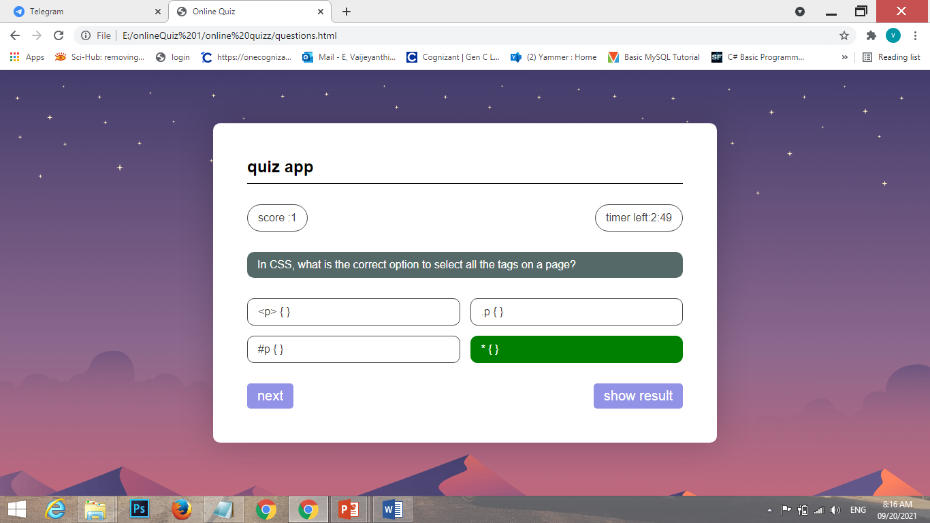
QUESTION PAGE SCREEN 1

Slide 13
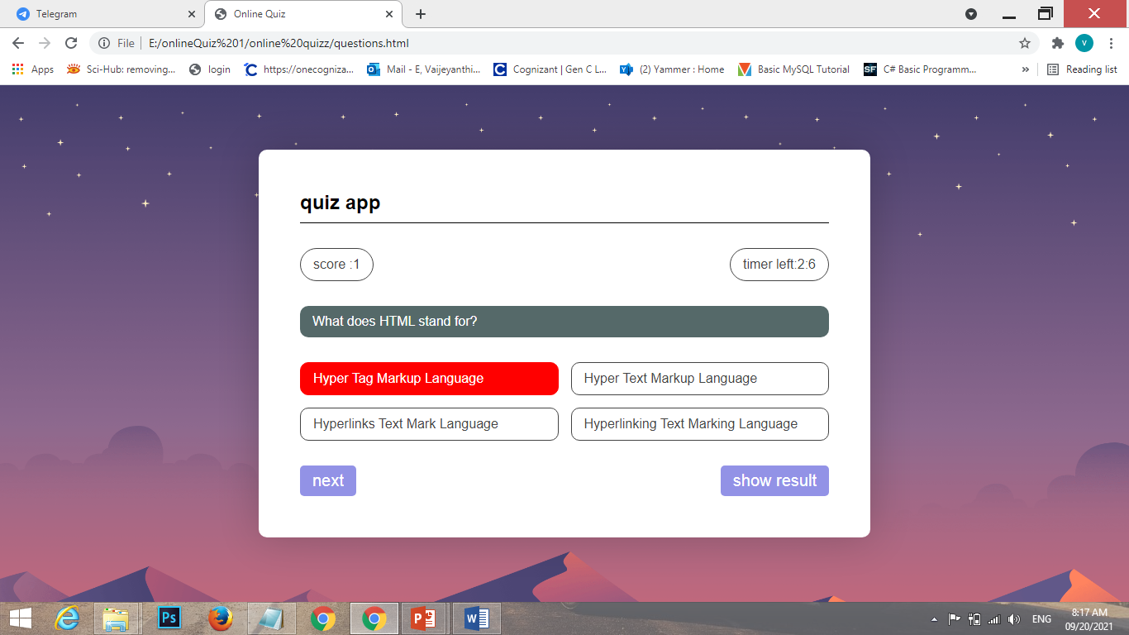
QUESTION PAGE SCREEN 2

Slide 14
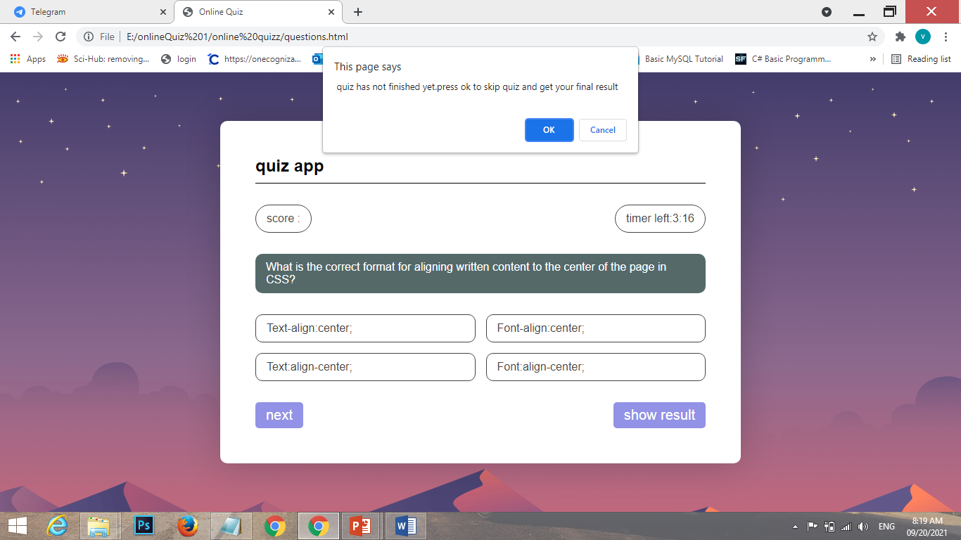
QUESTION PAGE SCREEN 3

Slide 15
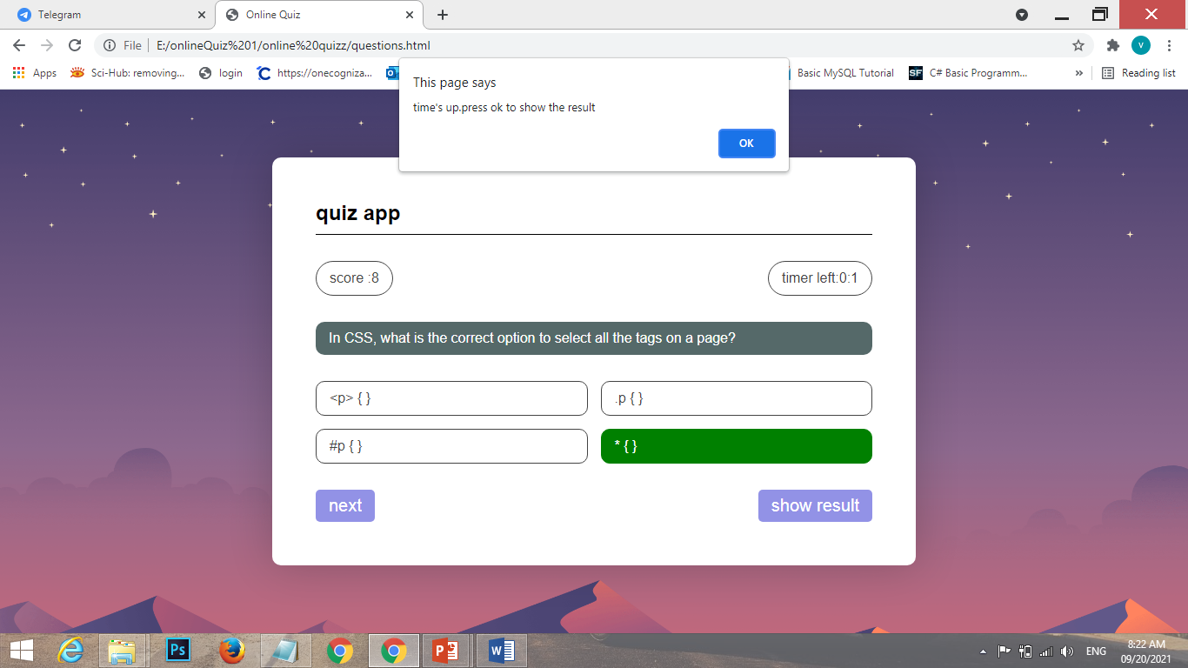
QUESTION PAGE SCREEN 4

Slide 16
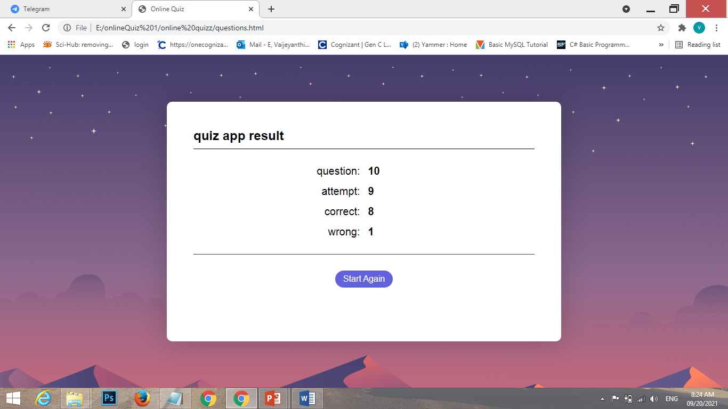
QUESTION PAGE SCREEN 5

Slide 17
ABOUT US
In this module, we can see the description of the quiz application which is very useful for the users to know about the our quiz application.

Slide 18
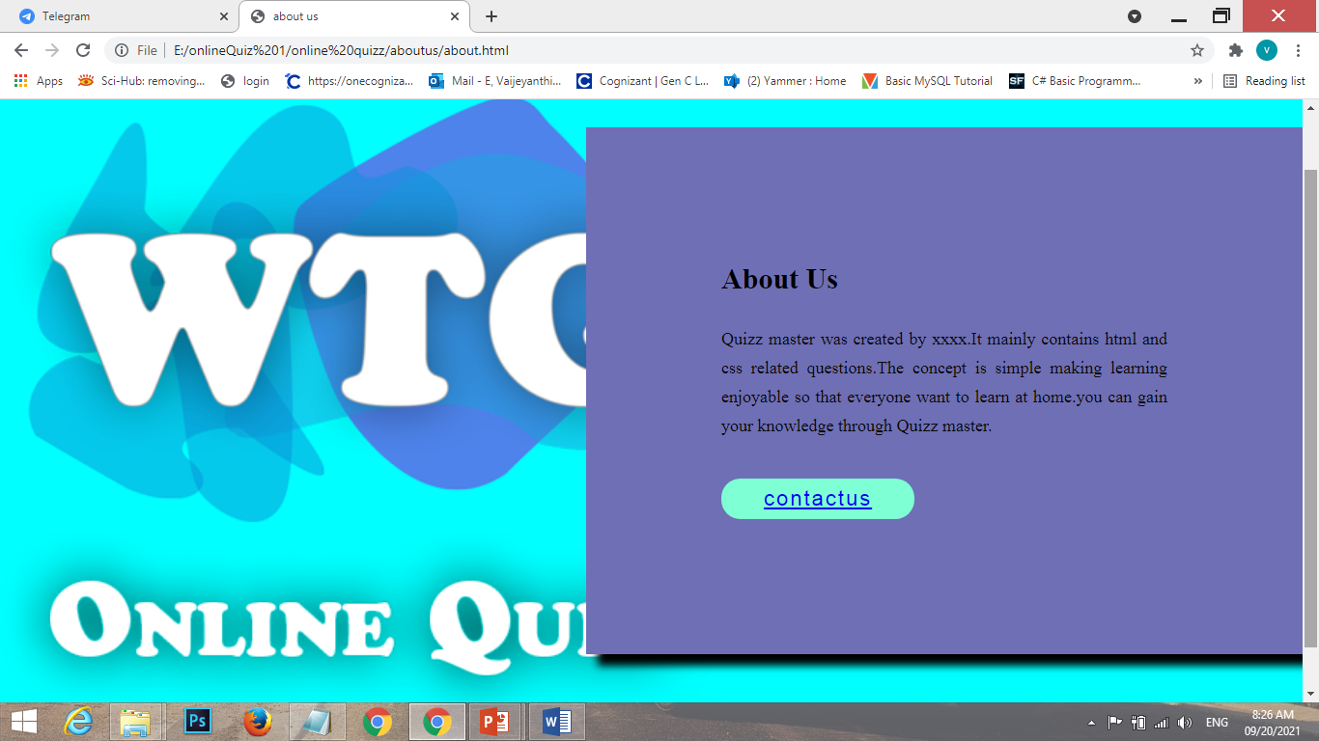
ABOUT US SCREEN

Slide 19
FEEDBACK
In this module, the user can give opinion using these page.
If the user not satisfied means, they hotel will be change according to the user

Slide 20
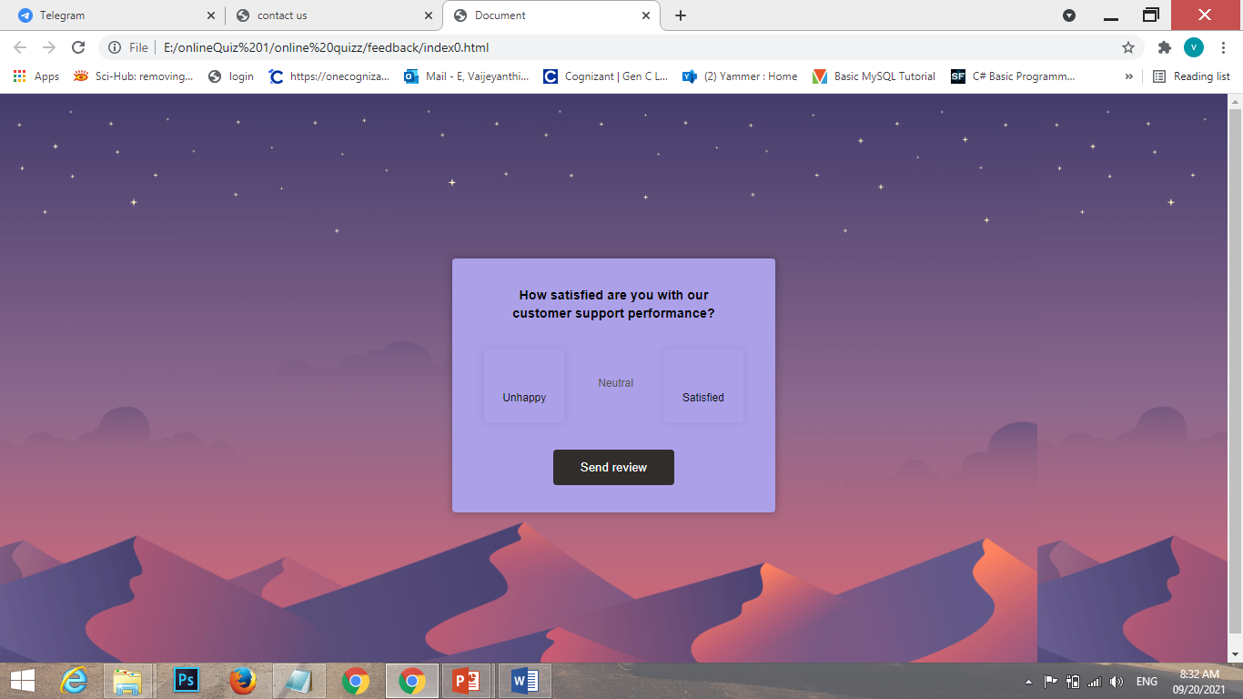
FEEDBACK SCREEN

Slide 21
CONTACT US
Contact us page that contain contact details of the quiz website and user can write message or contact to the through phone no and email.

Slide 22
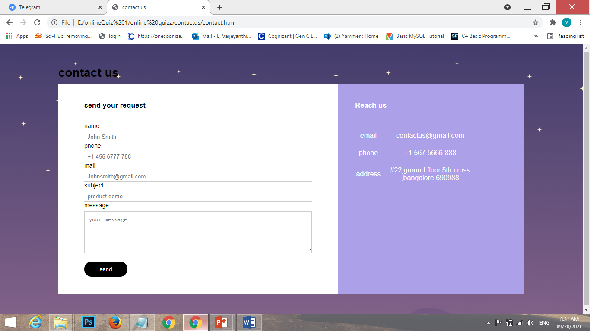
CONTACT US SCREEN

Slide 23
ADVANTAGES
It saves more time.
It saves papers.
Free of cost and user friendly.
It will improve knowledge.

Slide 24
CONCLUSION
The online quiz application provides facility to play quiz anywhere and anytime. It save time since user does need to wait for result. So student/user cannot wait for result.
All Student/user can get knowledge and skills .Administrator has a privilege to put as uh as question in any category given in application.
User can register ,log-in and give test with his/her specific id, and can see the result as well

Slide 25
THANK YOU

